Slide 1
Doctrine 2 – Next Generation ORM
Juozas „Joe“ Kaziukėnas (@juokaz)
Benjamin Eberlei (@beberlei)

Slide 2
ORM
Doctrine 2

Slide 3
PHP and ORMs
Object relational mapping
Current frameworks
  Propel (http://www.propelorm.org/)
  Doctrine 1.2 (http://www.doctrine-project.org/)

Slide 4
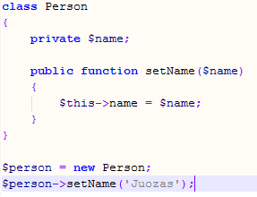
OOP

Slide 5
Object relational mapping
Models (objects)
Relations

Slide 6
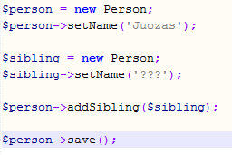
ORM (Active Record)

Slide 7
Querying
Different than SQL
  DQL in Doctrine
Working with models, not tables
  SELECT * FROM Model_Blog B WHERE B.id = 1
Very complicated internals
Database driver specific functionality

Slide 8
Performance and overhead
Hydration (from SQL results to objects)
SQL optimization
Memory usage
Lots of classes and very complicated underlying code
Other issues

Slide 9
Why do you need all this?
Faster coding
“Logical” application
Clear business logic
Standards
Not limited to (relational) databases
... Much more

Slide 10
ORM
Doctrine 2

Slide 11
Doctrine 2
Complete Rewrite of Doctrine 1
PHP 5.3 and Namespaces
3 Main Packages
  Common
  DBAL
  ORM
To be released on September 1st 2010
http://www.doctrine-project.org

Slide 12
Doctrine\Common
Cache
ClassLoader
AnnotationParser
Collections (OO-Arrays)
Events

Slide 13
Doctrine\DBAL
„Implements“ PDO API
Inspired by Zend_Db, ezcDatabase and PEAR MDB2
Convenience Methods
Database Schema Abstraction
Database Type Abstraction
Soon: SQL Query Object

Slide 14
Supported Doctrine\DBAL Vendors
PDO
  MySQL
  PostgreSQL
  Sqlite
  DB2
  SqlSrv
OCI8
IBM_DB2

Slide 15
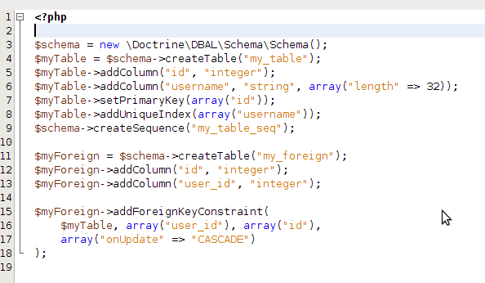
Doctrine\DBAL\Schema

Slide 16
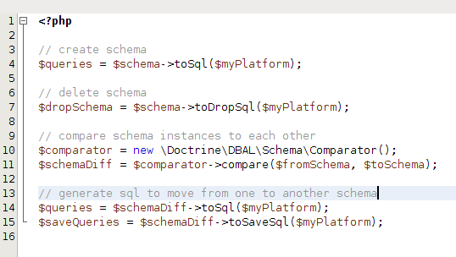
Doctrine\DBAL\Schema

Slide 17
Doctrine\ORM Architecture
DataMapper (no Active Record)
  Plain Old PHP Object (No Base Class or Interface)
  Using PHP 5.3 Reflection
Clean API
Killed the Magic
Focus on Persistence
Based on JSR-317/JPA Specification

Slide 18
Doctrine\ORM Architecture
Entities
  Not a final class or contain any final methods.
  Restrictions for __wakeup() or __clone()
  Constructor is never invoked by Doctrine (!)
  May contain non-optional constructor arguments
  May be part of inheritance hierachy
  Object Assocations are Relations in Database

Slide 19
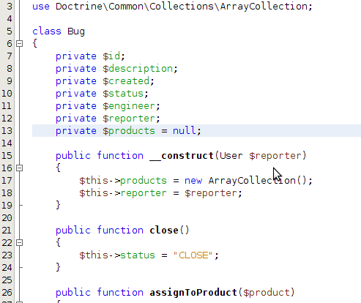
Example Entity

Slide 20
Doctrine\ORM Metadata Mapping
Several Supported Mapping Drivers
  Annotations (In PHPDoc)
  XML
  YAML
  Plain PHP
  Database (Reverse Engineering)

Slide 21
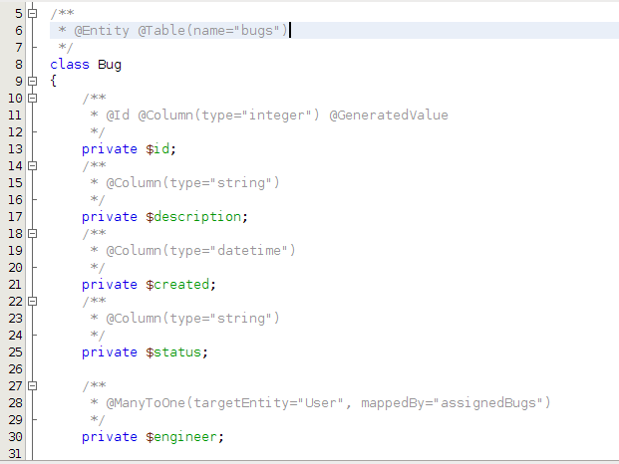
Doctrine\ORM Annotation Mapping

Slide 22
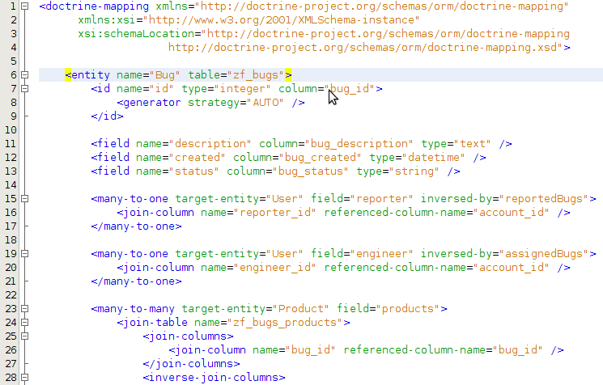
Doctrine\ORM XML Mapping

Slide 23
Doctrine\ORM\UnitOfWork
Doctrine\ORM\EntityManager Primary API
Transactional Write Behind (uff?)
  Aggregate Database Writes with EntityManager::flush()
  Always wrapped in single Transaction
  No explicit update trigger necessary
  Impressive Write Performance:
    Insert 10000 Objects in 3.5 (Sqlite), 6.4 (MySQL), 9.1 (Postgres) or 9.8 (Oracle) seconds
    Magnitudes Faster than Propel 1.5 (5x) and Doctrine 1 (9x)

Slide 24
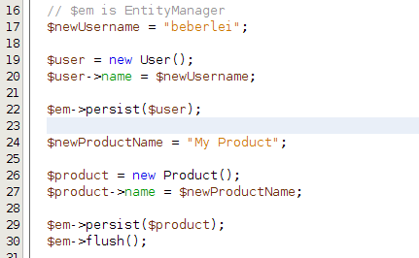
Lifecycle: Persist New Entities

Slide 25
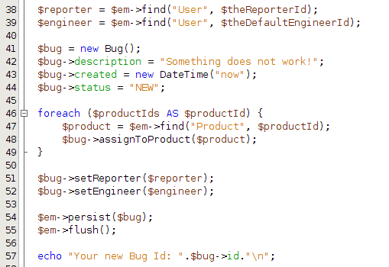
Lifecycle: Find Entities By ID

Slide 26
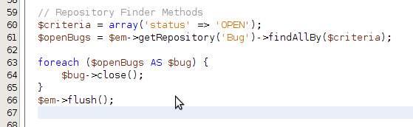
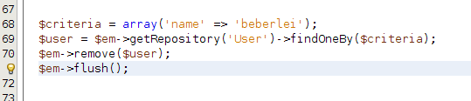
Lifecycle: Update and Remove

Slide 27
Doctrine Query Language
Object Query Language
SQL Like Syntax using Class- and Field-Names
DQL Query transformed into:
  SQL Query
  Column to Class & Field Mappings
  Both cached for zero overhead of DQL!
SELECT, UPDATE, DELETE
Optionally Query Builder
Full Result Set Hydration or Iterator

Slide 28
Doctrine Query Language
High read performance, 10000 Rows
  A Scalar set of rows: 0.17 secs
  Array Hydration: 0.34 secs
  Two-Level Nested Array Hydration: 0.75 secs
  Objects without Proxies: 0.68 secs
  Objects with Proxies: 2.73
How does this relate?
  About as fast as Propel 1.5
  20-700% faster as Doctrine 1

Slide 29
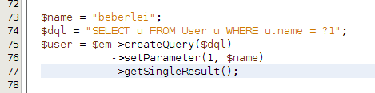
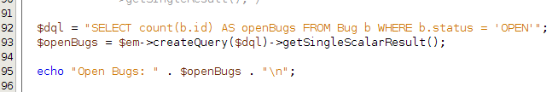
Simple DQL Query

Slide 30
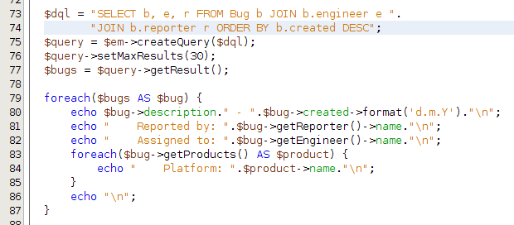
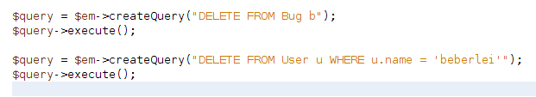
Advanced DQL Query

Slide 31
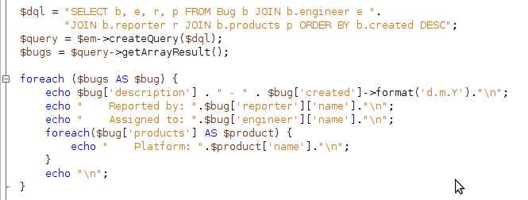
DQL Array Hydration

Slide 32
DQL Array Hydration SQL
SELECT z0_.bug_description AS bug_description0, z0_.bug_created AS bug_created1, z0_.bug_status AS bug_status2, z0_.bug_id AS bug_id3, z1_.account_name AS account_name4, z1_.account_id AS account_id5, z2_.account_name AS account_name6, z2_.account_id AS account_id7, z3_.product_name AS product_name8, z3_.product_id AS product_id9
FROM zf_bugs z0_ INNER JOIN zf_accounts z1_ ON z0_.engineer_id = z1_.account_id INNER JOIN zf_accounts z2_ ON z0_.reporter_id = z2_.account_id INNER JOIN zf_bugs_products z4_ ON z0_.bug_id = z4_.bug_id INNER JOIN zf_products z3_ ON z3_.product_id = z4_.product_id ORDER BY z0_.bug_created DESC

Slide 33
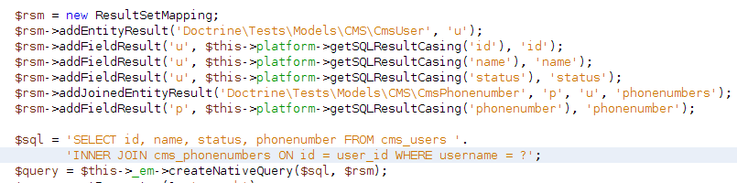
Native SQL
Remember: DQL = SQL + Result Mapping
Support for Native SQL Queries

Slide 34
More Features
Inheritance (All of Fowlers Three)
Optimistic and Pessimistic Locking
Mapping to DDL SQL Generation (Create, Update, Drop Schema)
Ordered Collections (by foreign field)
Lifecycle Event System
Composite Key Support
… and lots of stuff planned!

Slide 35
Thank you!
Rate a talk: http://joind.in/talk/view/1769

